Slide 1
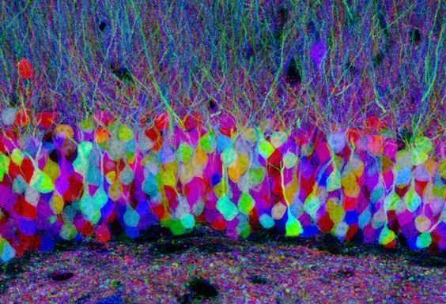

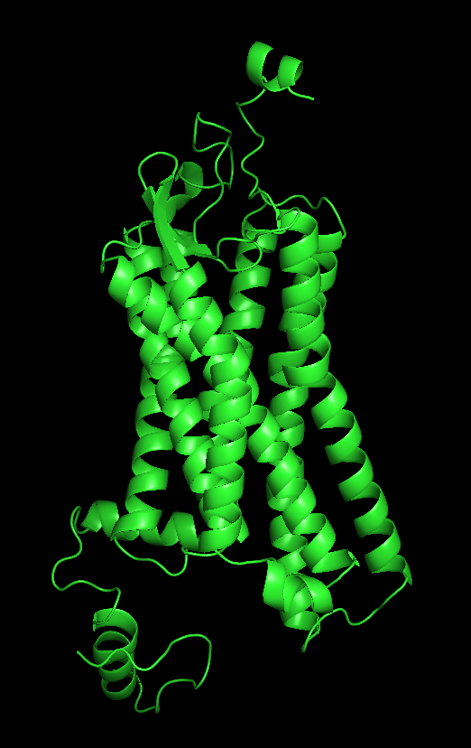
Integrative Modeling of Unbound and Dermorphin-Bound δ-Opioid Receptor
Ghadi El Hasbani
Rawan Tohme
BIF 435 Dr. Eileen-Marie Hanna

Slide 2
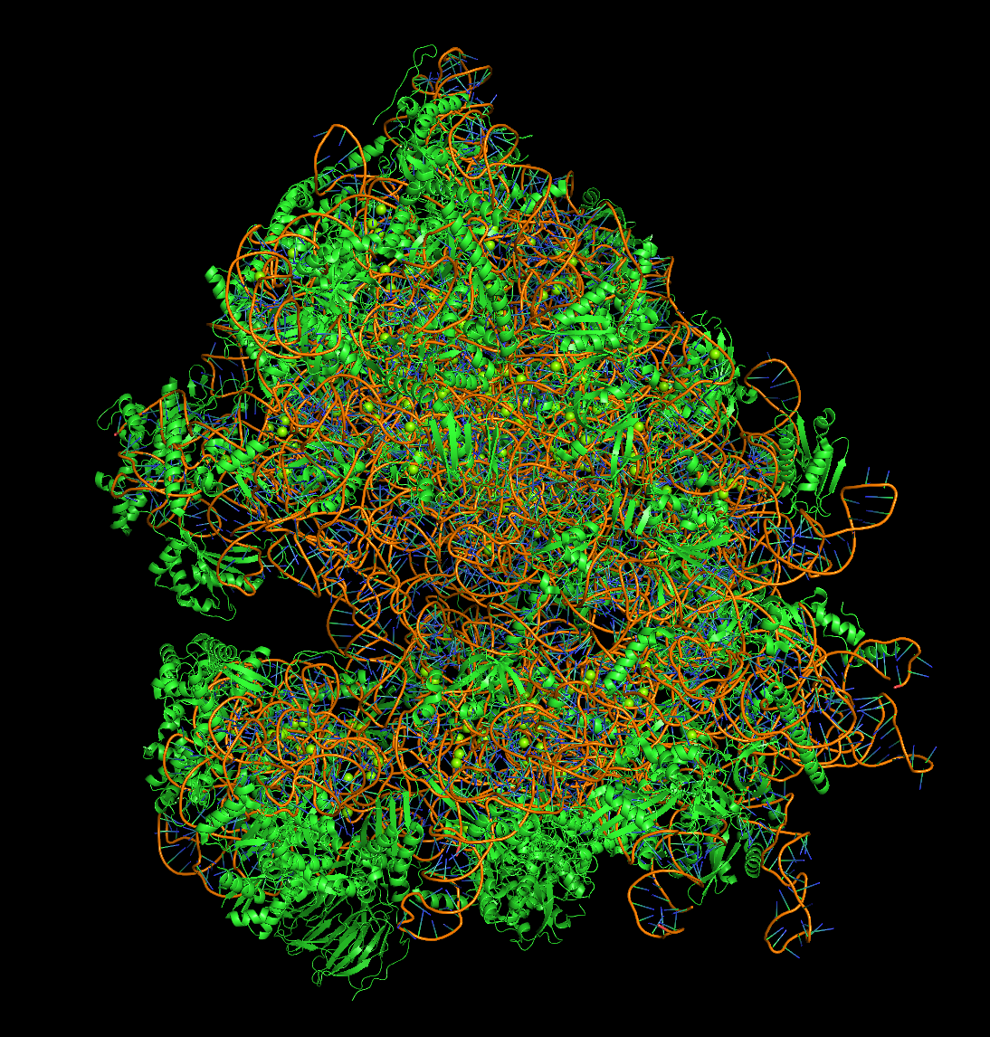
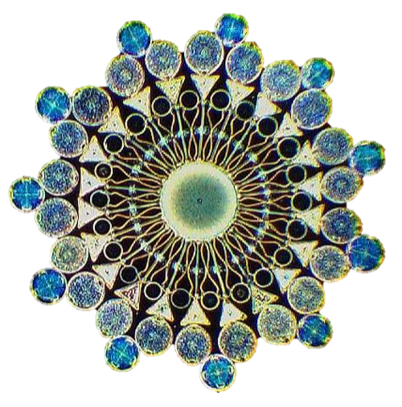
Table of contents
Background
Methods
Results
References
PDB ID: 7R81

Slide 3
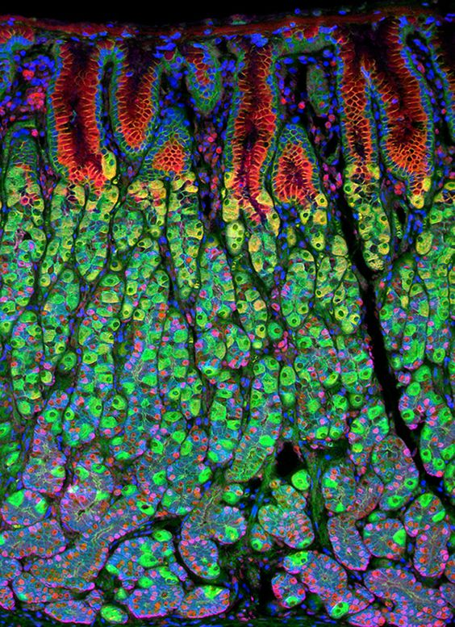
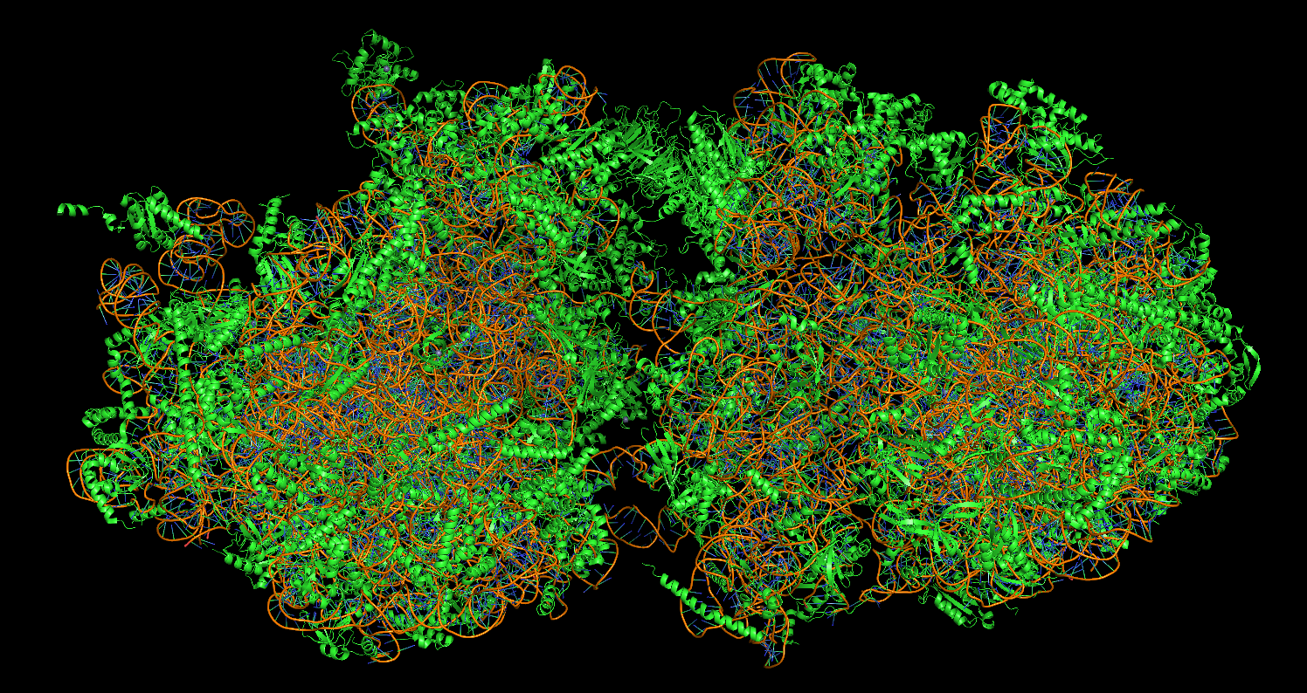
Background
PDB ID: 6I7O

Slide 4
Why Delta?
Ligands
Receptors
Properties
Antinociception,
Tolerance,
catalepsy
Tolerance, dependence, mood regulation
Anxiolytic, antidepressant,
Reduced adverse effects
Endogenous
-Endorphins
-Endomorphins
Exogenous
-morphin
-heroine
-dermorphins
-deltorphins
Mu
Kappa
Delta
Opioid Receptors
Class A GPCRs

Slide 5
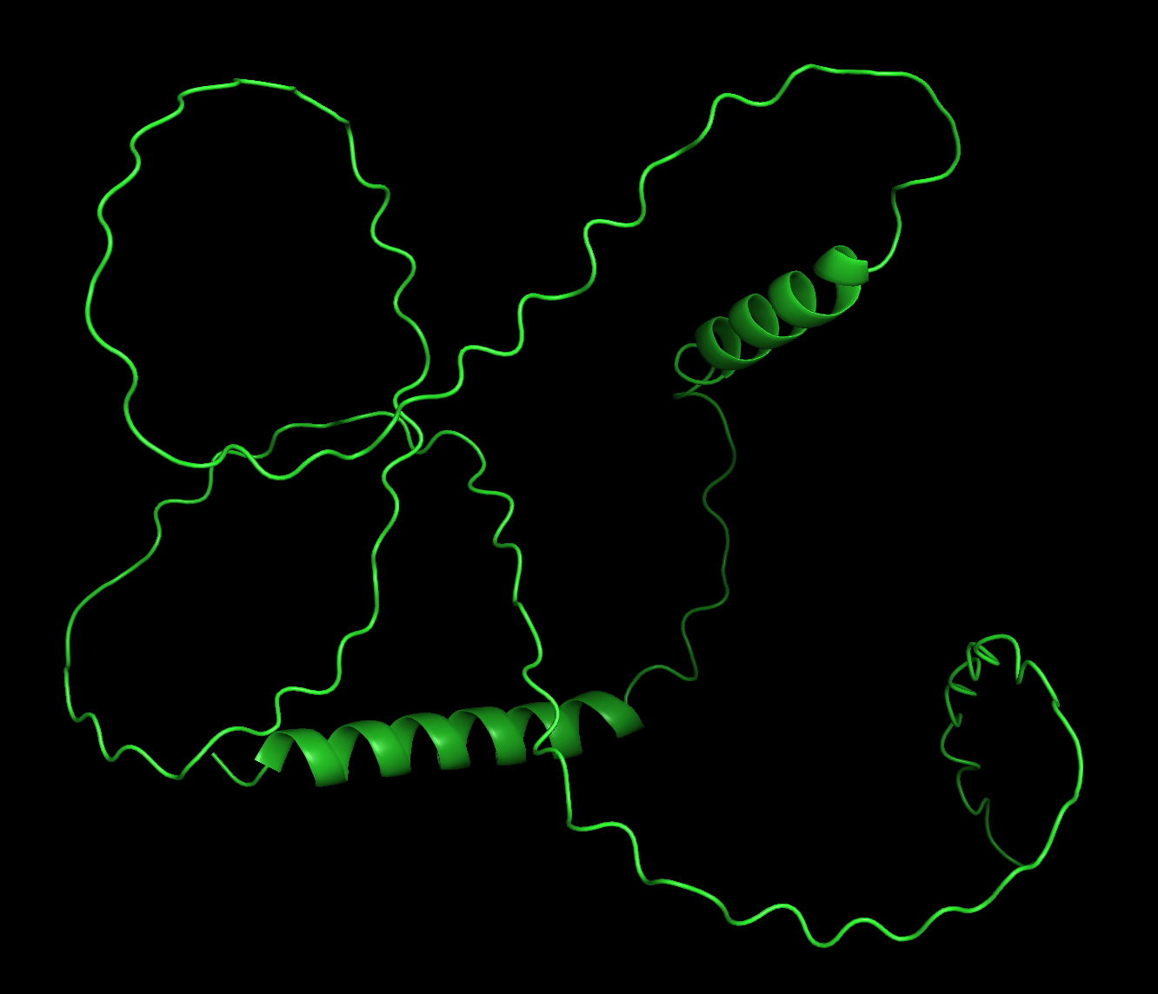

Why Dermorphin?
AlphaFold2 (UniProt ID: P05422)
Composition
48-54: Deltorphin
80-86, 115-121, 150-156, 185-191:
Dermorphin
YAFGYPS
Properties
High Affinity to Mu
30-40x more powerful than morphin
Less Addictve
Dermorphin-1
(1-197)
Phyllomedusa sauvagei

Slide 6
Existing Protocols
Challenges
Fully flexible peptide that is small but big!
Loops
Pros
Cons
Leelananda & Lindert (2017):
Rosetta-MD + Cryo-EM
Raveh et al. (2011):
FlexPepDock ab-initio
Badaczewska-Dawid et al. (2021):
CABS-dock-FlexPepDock
-Fully integrative model
-Unknown pepitde structure
-Highly optimized
Time-complexity,
Dependence on experimental data such as NMR or mutagenesis

Slide 7
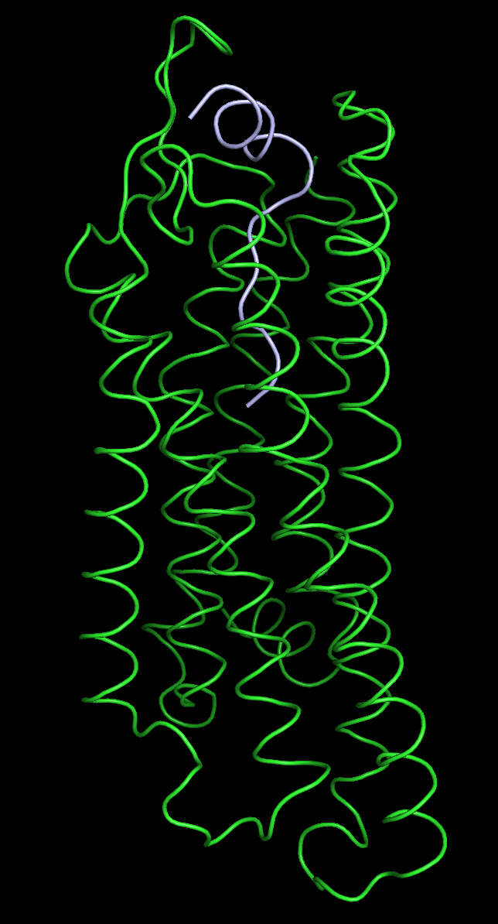
The only GPCR on PDB-Dev
Ghrelin bound to Growth Hormone Secretagogue Receptor
Bender et al. (2019):
RosettaCM-FlexPepDock
Iteratively build loops and peptide with RosettaCM interrupted by FlexPepDock docking – guided by NMR data
Faster and can be done without experimental data
Prevents loops from collapsing while optimizing binding
PDBDEV_00000024

Slide 8
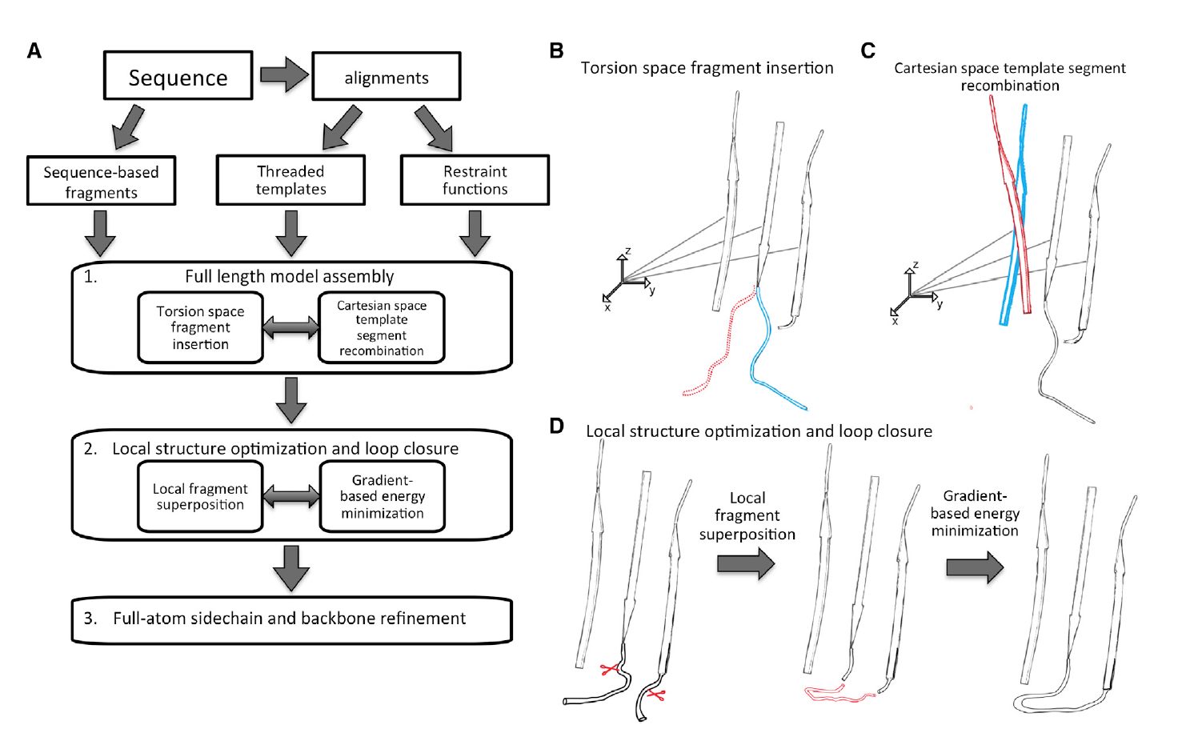
RosettaCM
(Song et al., 2013)

Slide 9
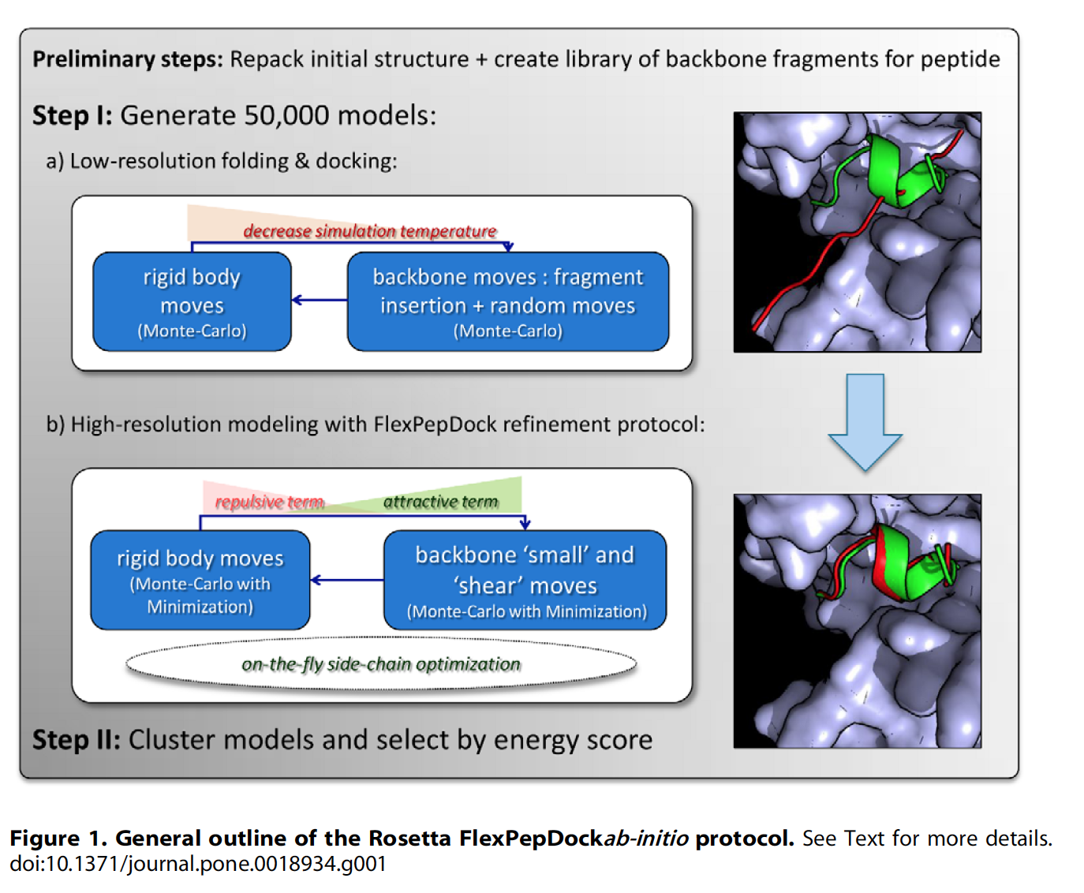
Rosetta FlexPepDock
Robetta Fragment server requires 27 < peptide sequence length < 1000
Refinement is effective alone if initial peptide within 5.5Å of native conformation
(Assumption taken)
(Raveh et al., 2011)

Slide 10
Goal
Integrate available structures
X-Ray Diffraction
Advantage:
accurate
Disadvantage:
limited
AlphaFold2 Theoretical Model
Advantage:
full sequence length
Disadvantage:
not experimentally valdated
Use to generate dermorphin-bound DOR with loops
Unbound DOR

Slide 11
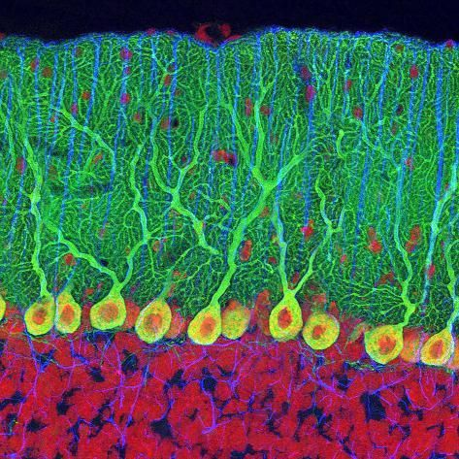
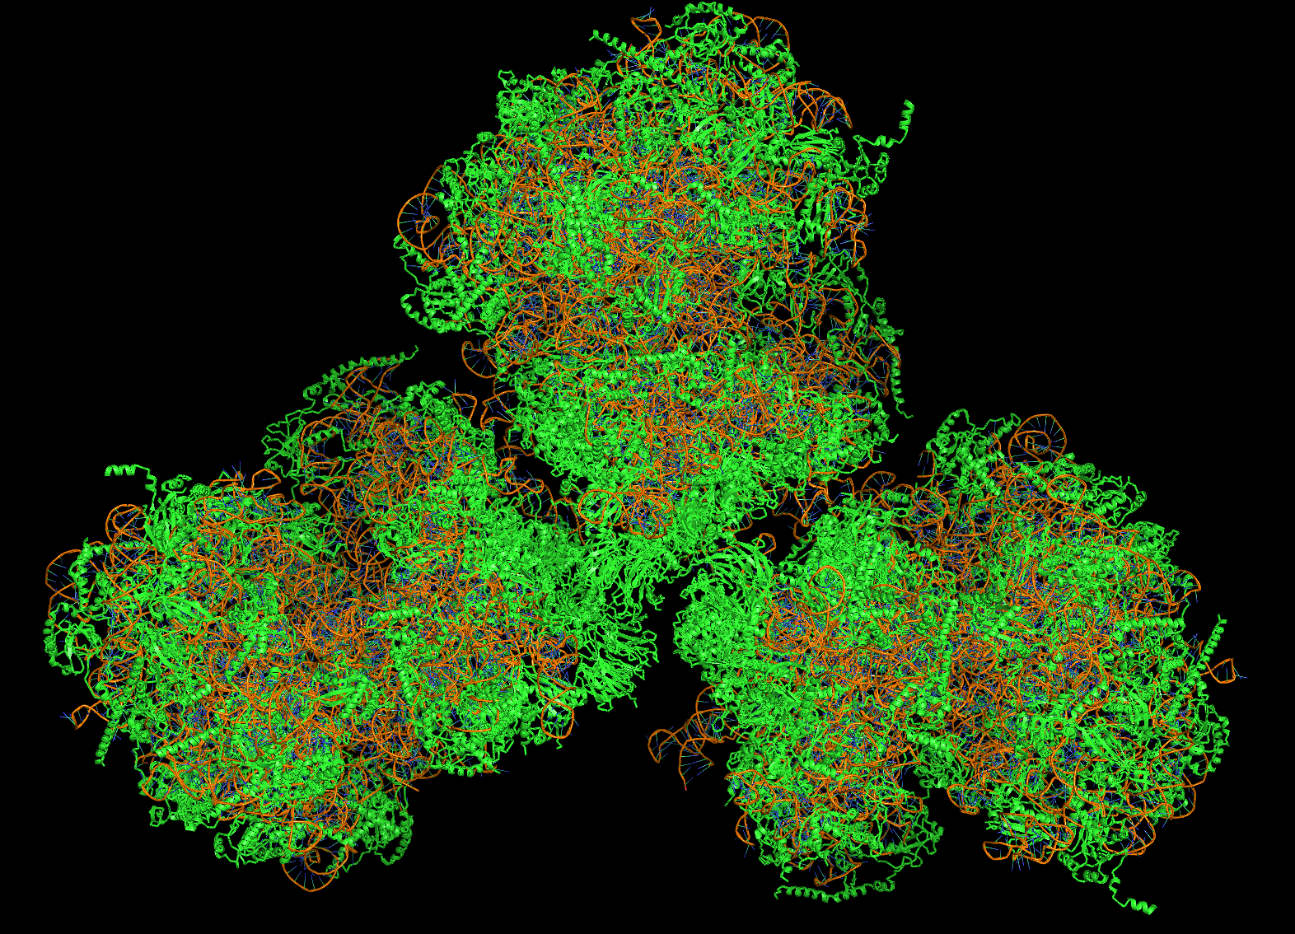
Methods
PDB ID: 6SV4

Slide 12
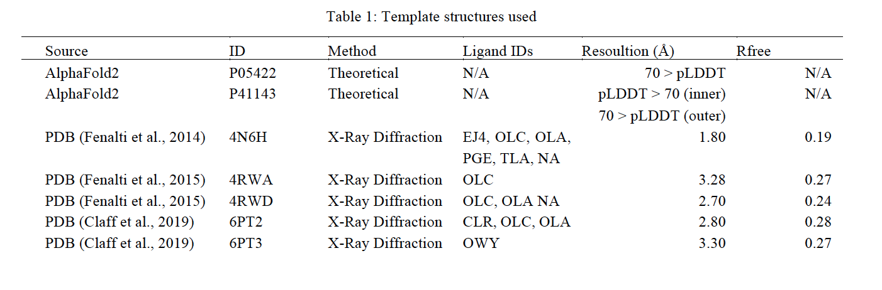
Data Preprocessing
UniProt
Cleaning: HETATMs, chains…
DOR target .fasta sequence
Threaded PDBs
chain As
ClustalO MSA + .grishin conversion
Threading
.grishin alignment files

Slide 13
First Iteration
DOR target .fasta sequence
Disulfide constraints file
Specified in
TOPCONS2 + conversion to .span file
Rosetta protocol .options file
Membrane span constraints file
3 unbound structures
Image created using Mol* (PDB ID: 4N6H)
Filter based on lowest Total Rosetta Score (TRS)
Rosetta .xml script
Best Unbound Structure
Membrane weight files
Specified in
Protein Structure Validation Suite (PSVS)
Standard protocol with FastRelax
Threaded PDB templates
Rosetta package
Quality Report

Slide 14
Second Iteration
PSVS
Best Bound Structure
Quality Report
Best Unbound Structure
Dermorphin-1 AlphaFold2
Filter based on lowest TRS
Truncate
10 refined bound models
Dermorphin (80-86)
Truncated
FlexPepDock 2
HPEPDOCK
1 full structure
Initial bound model
Standard prepacking flags file
Prepacking
RosettaCM 2
Updated constraints file
Add full atom constraint for a residue/chain pair
Specified in
Templates for
FlexPepDock 1
Standard refine flags file
1 refined model
3 unbound structures + AlphaFold2
Disulfide constraints file

Slide 15
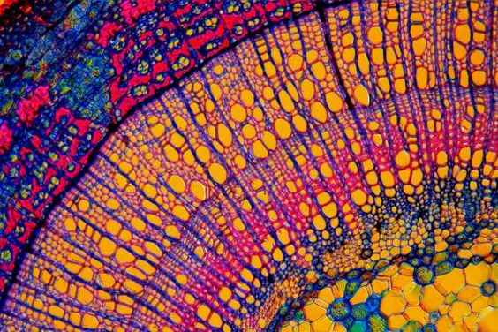
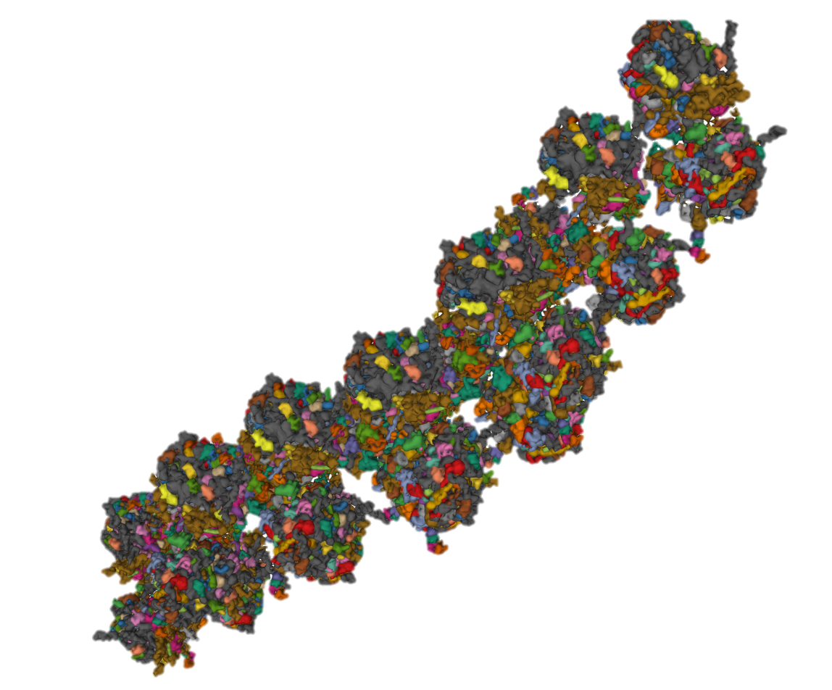
Results
PDB ID: 4V3P

Slide 16
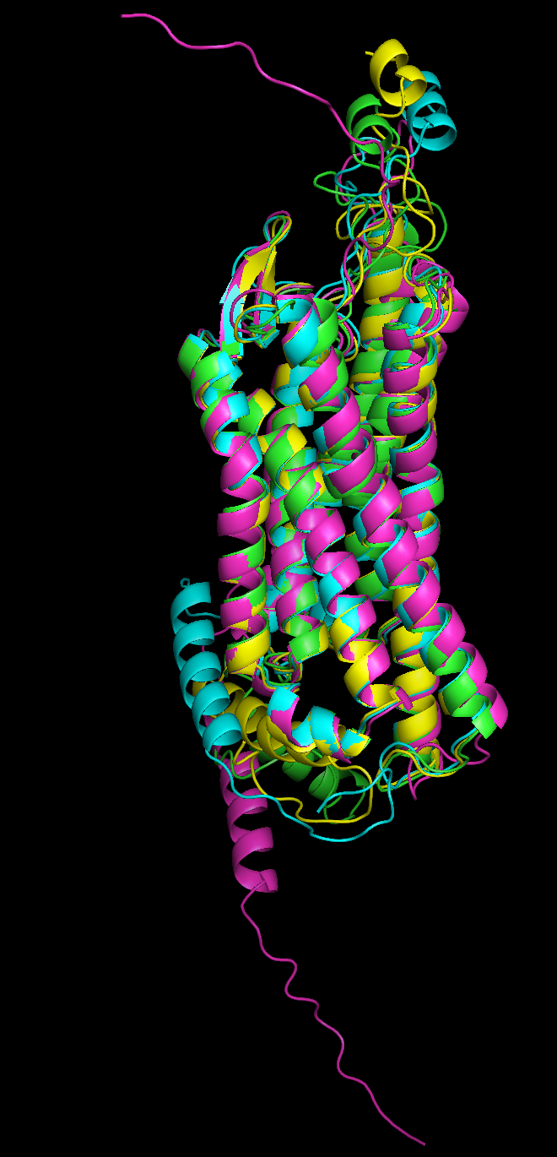
Unbound
Alignment of 3 Unbound models with AlphaFold2 model
Best Unbound Model

Slide 17
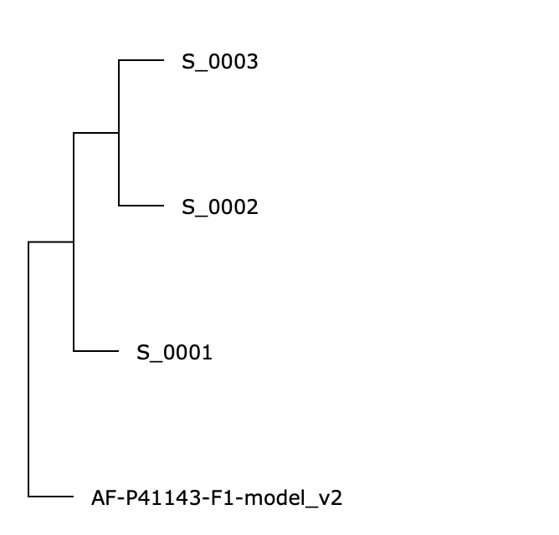
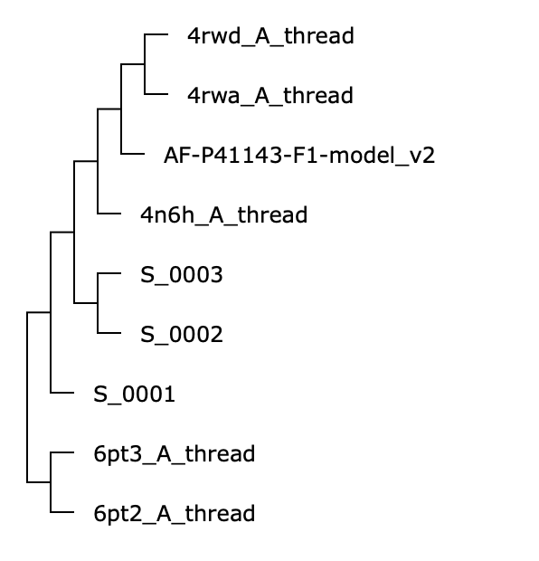
mTM-Align

Slide 18
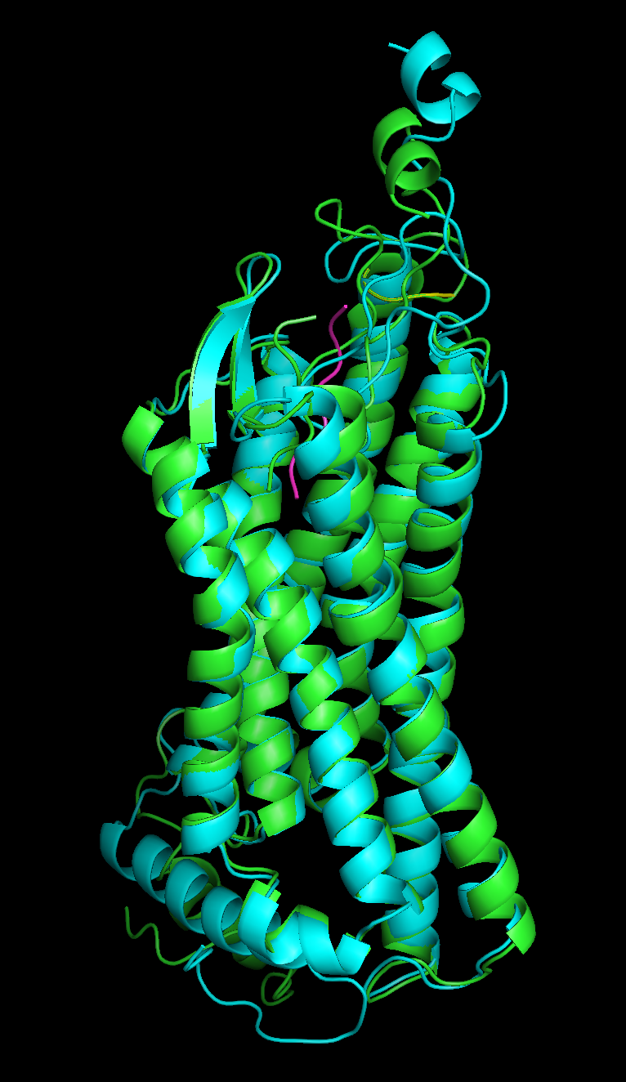
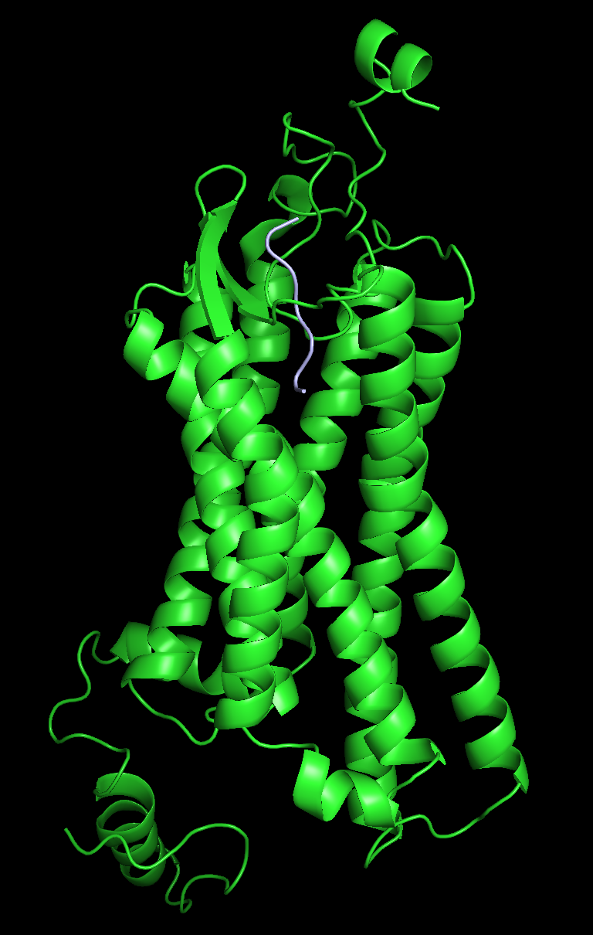
Bound
Alignment of HPEPDOCK, best bound, best unbound models
Best Bound Model

Slide 19
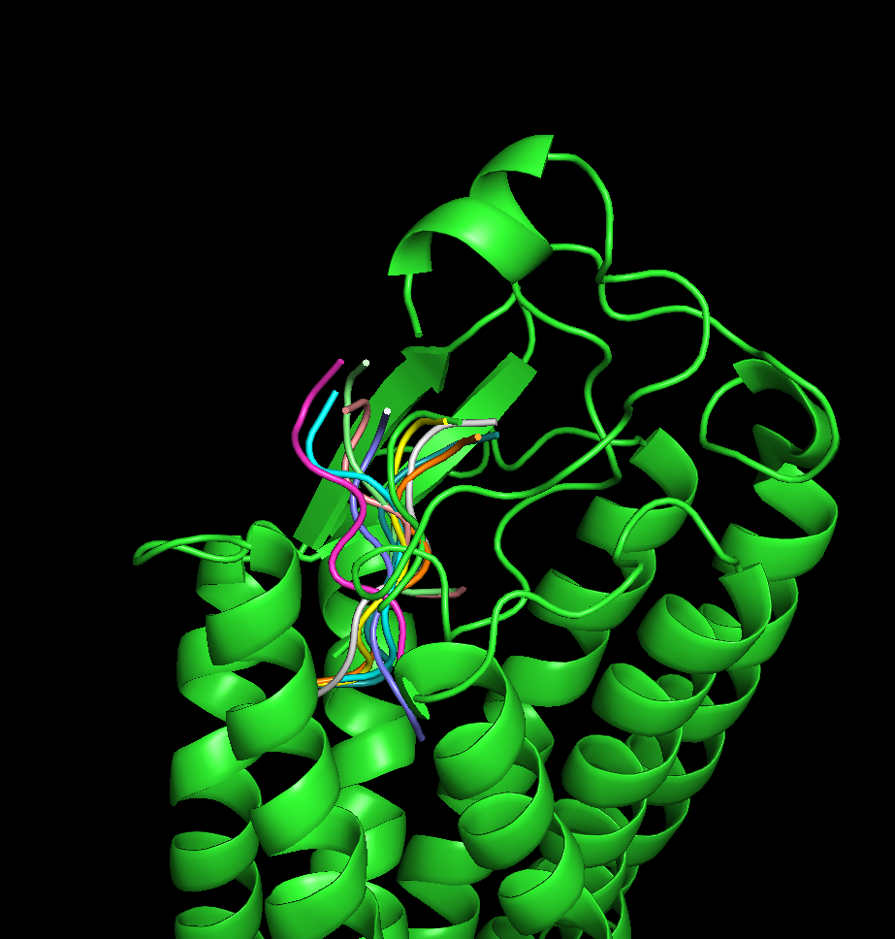
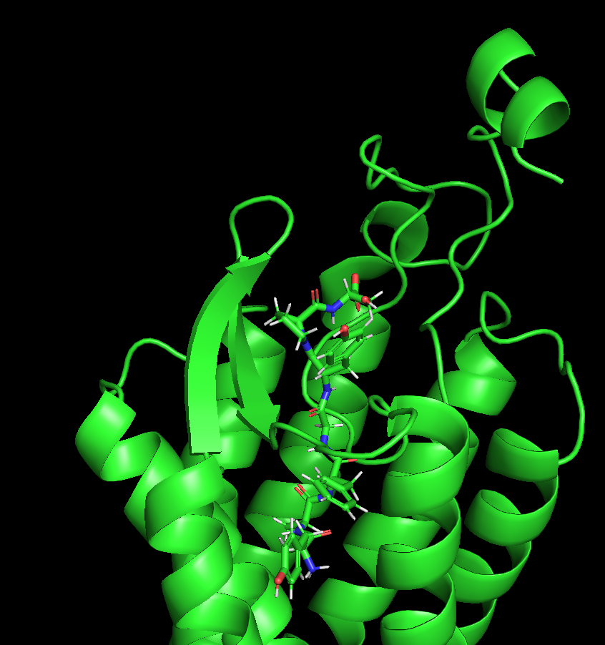
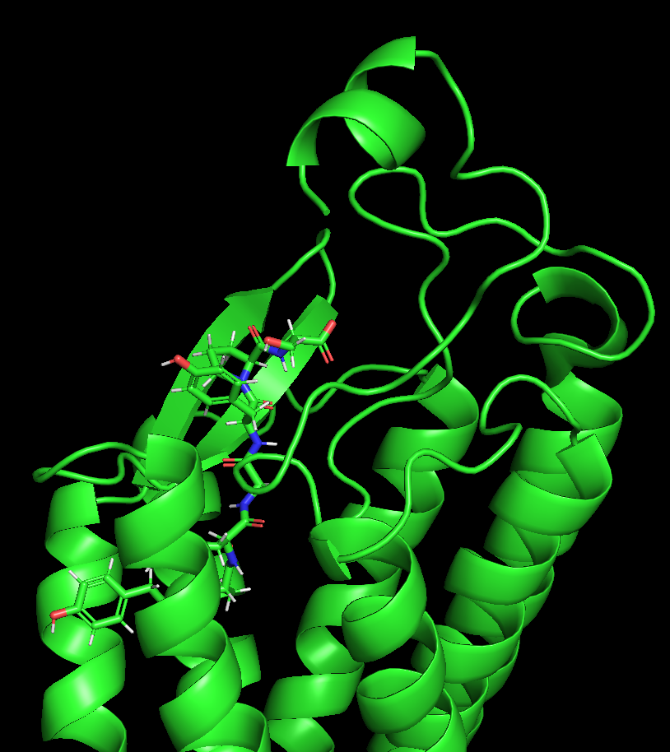
Bound
Residue pairs found n proximity using Chimera:
TRP216 – TYR1 ASP28 – TYR5
ARG199 – PRO6 PHE209 – PHE3
TYR136 – TYR1
Alignment of 10 bound conformations

Slide 20
StralCP

Slide 21
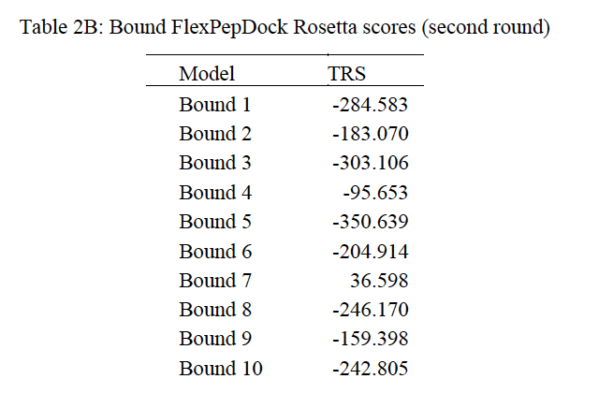
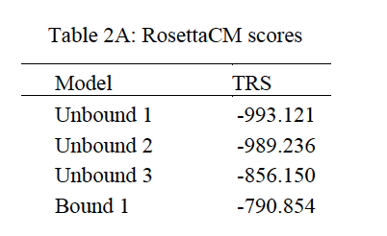
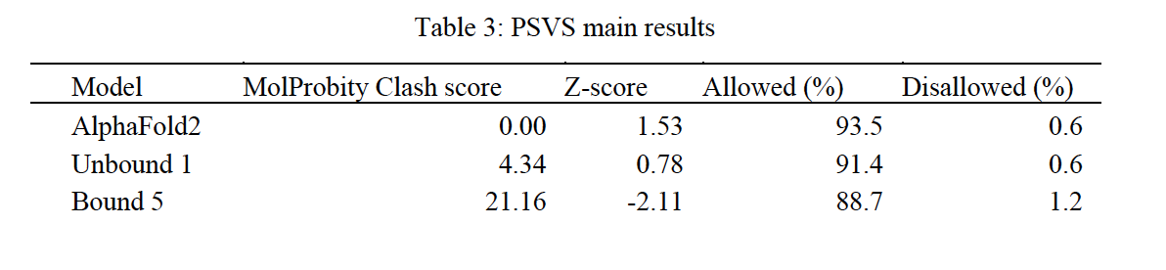
Quality

Slide 22
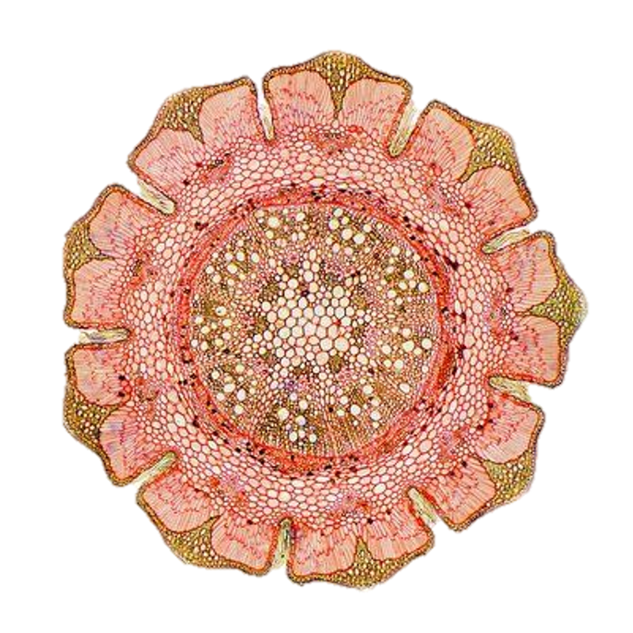
Concluding Thoughts
Model quality is not bad but not good either
Loops did not significantly relocate → problematic binding?
Involved residues congruent with literature
Future Recommendations:
Better PDB cleaning, constraints, and sampling
Incorporating biological data and MD simulations
Consideration of D-ALA2, DOR’s Na⁺, and PTMs
Comparison to other ligands, receptors, or oligomers of same receptor

Slide 23
References
Allouche, S., Noble, F., & Marie, N. (2014). Opioid receptor desensitization: mechanisms and its link to tolerance. Frontiers in pharmacology, 5, 280.
Apweiler, R., Bairoch, A., Wu, C. H., Barker, W. C., Boeckmann, B., Ferro, S., ... & Yeh, L. S. L. (2004). UniProt: the universal protein knowledgebase. Nucleic acids research, 32(suppl_1), D115-D119.
Badaczewska-Dawid, A. E., Kmiecik, S., & Koliński, M. (2021). Docking of peptides to GPCRs using a combination of CABS-dock with FlexPepDock refinement. Briefings in bioinformatics, 22(3), bbaa109.acids research, 46(W1), W443-W450.
Bender, B. J., Vortmeier, G., Ernicke, S., Bosse, M., Kaiser, A., Els-Heindl, S., ... & Huster, D. (2019). Structural model of ghrelin bound to its G protein coupled receptor. Structure, 27(3), 537-544.
Bhattacharya, A., Tejero, R., & Montelione, G. T. (2007). Evaluating protein structures determined by structural genomics consortia. Proteins: Structure, Function, and Bioinformatics, 66(4), 778-795.
Broccardo, M., Erspamer, V., Falconieri, G., Improta, G., Linari, G., Melchiorri, P., & Montecucchi, P. C. (1981). Pharmacological data on dermorphins, a new class of potent opioid peptides from amphibian skin. British journal of pharmacology, 73(3), 625-631.
Burley, S. K., Kurisu, G., Markley, J. L., Nakamura, H., Velankar, S., Berman, H. M., ... & Trewhella, J. (2017). PDB-Dev: a prototype system for depositing integrative/hybrid structural models. Structure, 25(9), 1317-1318.

Slide 24
References
Chu Sin Chung, P. C., and Kieffer, B. L. (2013). Delta opioid receptors in brain function and diseases. Pharmacol. Ther. 140, 112–120. doi:10.1016/j.pharmthera.2013.06.003
Claff, T., Yu, J., Blais, V., Patel, N., Martin, C., Wu, L., ... & Stevens, R. C. (2019). Elucidating the active δ-opioid receptor crystal structure with peptide and small-molecule agonists. Science advances, 5(11), eaax9115.
Das, R., & Baker, D. (2008). Macromolecular modeling with rosetta. Annu. Rev. Biochem., 77, 363-382.
DeLano, W. L. (2002). PyMOL.
Dong, R., Pan, S., Peng, Z., Zhang, Y., & Yang, J. (2018). mTM-align: a server for fast protein structure database search and multiple protein structure alignment. Nucleic acids research, 46(W1), W380-W386.
Dong, R., Peng, Z., Zhang, Y., & Yang, J. (2018). mTM-align: an algorithm for fast and accurate multiple protein structure alignment. Bioinformatics, 34(10), 1719-1725.
D. Sehnal, S. Bittrich, M. Deshpande, R. Svobodov., K. Berka, V. Bazgier, S. Velankar, S.K. Burley, J. Koča, A.S. Rose (2021) Mol* Viewer: modern web app for 3D visualization and analysis of large biomolecular structures. Nucleic Acids Research. doi: 10.1093/nar/gkab314
Fenalti, G., Giguere, P. M., Katritch, V., Huang, X. P., Thompson, A. A., Cherezov, V., ... & Stevens, R. C. (2014). Molecular control of δ-opioid receptor signalling. Nature, 506(7487), 191-196.

Slide 25
References
Fenalti, G., Zatsepin, N. A., Betti, C., Giguere, P., Han, G. W., Ishchenko, A., ... & Cherezov, V. (2015). Structural basis for bifunctional peptide recognition at human δ-opioid receptor. Nature structural & molecular biology, 22(3), 265-268.
Gav.riaux-Ruff, C., and Kieffer, B. L. (2011). Delta opioid receptor analgesia: recent contributions from pharmacology and molecular approaches. Behav. Pharmacol. 22, 405–414. doi: 10.1097/fbp.0b013e32834a1f2c
Goldenberg, D. L. (2010b). The interface of pain and mood disturbances in the rheumatic diseases. Semin. Arthritis Rheum. 40, 15–31. doi: 10.1016/j.semarthrit.2008.11.005
Greife, A., Felekyan, S., Ma, Q., Gertzen, C. G., Spomer, L., Dimura, M., ... & Seidel, C. A. (2016). Structural assemblies of the di-and oligomeric Gprotein coupled receptor TGR5 in live cells: an MFIS-FRET and integrative modelling study. Scientific reports, 6(1), 1-16.
H.M. Berman, J. Westbrook, Z. Feng, G. Gilliland, T.N. Bhat, H. Weissig, I.N. Shindyalov, P.E. Bourne. (2000) The Protein Data Bank Nucleic Acids Research, 28: 235-242.
H.M. Berman, K. Henrick, H. Nakamura (2003) Announcing the worldwide Protein Data Bank Nature Structural Biology 10 (12): 980. www.wwpdb.org
Jumper, J., Evans, R., Pritzel, A., Green, T., Figurnov, M., Ronneberger, O., ... & Hassabis, D. (2021). Highly accurate protein structure prediction with AlphaFold. Nature, 596(7873), 583-589. https://doi.org/10.1038/s41586-021-03819-2

Slide 26
References
Pettersen, E. F., Goddard, T. D., Huang, C. C., Couch, G. S., Greenblatt, D. M., Meng, E. C., & Ferrin, T. E. (2004). UCSF Chimera—a visualization system for exploratory research and analysis. Journal of computational chemistry, 25(13), 1605-1612.
Kastin, A. (Ed.). (2013). Handbook of biologically active peptides. Academic press.
Kurcinski, M., Badaczewska-Dawid, A., Kolinski, M., Kolinski, A., & Kmiecik, S. (2020). Flexible docking of peptides to proteins using CABSdock. Protein Science, 29(1), 211-222.
Lazarus, L. H., Wilson, W. E., Guglietta, A., & De Castiglione, R. (1990). Dermorphin interaction with rat brain opioid receptors: involvement of hydrophobic sites in the binding domain. Molecular pharmacology, 37(6), 886-892.
Leelananda, S. P., & Lindert, S. (2017). Iterative molecular dynamics–rosetta membrane protein structure refinement guided by cryo-em densities. Journal of chemical theory and computation, 13(10), 5131-5145.
London, N., Raveh, B., Cohen, E., Fathi, G., & Schueler-Furman, O. (2011). Rosetta FlexPepDock web server—high resolution modeling of peptide–protein interactions. Nucleic acids research, 39(suppl_2), W249-W253.
Patra, M. C., Kumar, K., Pasha, S., & Chopra, M. (2012). Comparative modeling of human kappa opioid receptor and docking analysis with the peptide YFa. Journal of Molecular Graphics and Modelling, 33, 44-51.

Slide 27
References
Quirion, B., Bergeron, F., Blais, V., & Gendron, L. (2020). The delta-opioid receptor; a target for the treatment of pain. Frontiers in Molecular Neuroscience, 13, 52.
Raveh, B., London, N., & Schueler-Furman, O. (2010). Sub-angstrom modeling of complexes between flexible peptides and globular proteins. Proteins: Structure, Function, and Bioinformatics, 78(9), 2029-2040.
Raveh, B., London, N., Zimmerman, L., & Schueler-Furman, O. (2011). Rosetta FlexPepDock ab-initio: simultaneous folding, docking and refinement of peptides onto their receptors. PloS one, 6(4), e18934.
Rohl, C. A., Strauss, C. E., Misura, K. M., & Baker, D. (2004). Protein structure prediction using Rosetta. In Methods in enzymology (Vol. 383, pp. 66-93). Academic Press.
Sievers, F., & Higgins, D. G. (2014). Clustal omega. Current protocols in bioinformatics, 48(1), 3-13.
Sievers, F., & Higgins, D. G. (2014). Clustal Omega, accurate alignment of very large numbers of sequences. In Multiple sequence alignment methods (pp.105-116). Humana Press, Totowa, NJ.
Ślusarz, M. J. (2011). Molecular modeling study of the opioid receptor interactions with series of cyclic deltorphin analogues. Journal of Peptide Science, 17(8), 554-564.
Song, Y., DiMaio, F., Wang, R. Y. R., Kim, D., Miles, C., Brunette, T. J., ... & Baker, D. (2013). High-resolution comparative modeling with RosettaCM. Structure, 21(10), 1735-1742.

Slide 28
References
Tsirigos, K. D., Peters, C., Shu, N., K.ll, L., & Elofsson, A. (2015). The TOPCONS web server for consensus prediction of membrane protein topologyand signal peptides. Nucleic acids research, 43(W1), W401-W407.
Vats, I. D., Dolt, K. S., Kumar, K., Karar, J., Nath, M., Mohan, A., ... & Pasha, S. (2008). YFa, a chimeric opioid peptide, induces kappa-specific antinociception with no tolerance development during 6 days of chronic treatment. Journal of neuroscience research, 86(7), 1599-1607.
Viklund, H., & Elofsson, A. (2008). OCTOPUS: improving topology prediction by two-track ANN-based preference scores and an extended topological grammar. Bioinformatics, 24(15), 1662-1668.
Zemla, A., Geisbrecht, B., Smith, J., Lam, M., Kirkpatrick, B., Wagner, M., ... & Zhou, C. E. (2007). STRALCP—structure alignment-based clustering of proteins. Nucleic acids research, 35(22), e150-e150.
Zhou, P., Jin, B., Li, H., & Huang, S. Y. (2018). HPEPDOCK: a web server for blind peptide–protein docking based on a hierarchical algorithm. Nucleic
Zhou, P., Li, B., Yan, Y., Jin, B., Wang, L., & Huang, S. Y. (2018). Hierarchical flexible peptide docking by conformer generation and ensemble docking of peptides. Journal of Chemical Information and Modeling, 58(6), 1292-1302.

Slide 29
Table of contents
Background
Methods
Results
References
PDB ID: 7R81

Slide 30
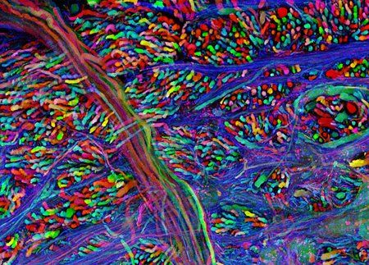
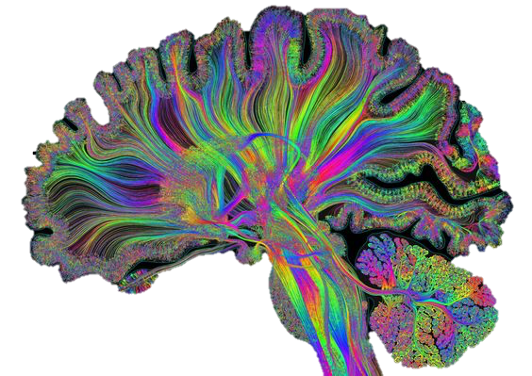
Thank You

